Slide 1
GREEDY ALGORITHM
ALGORITHM ANALYSIS
<<professor>>
Computer Science Department

Slide 2
OPTIMIZATION PROBLEMS
An optimization problem is one in which you want to find, not just a solution, but the best solution
A “greedy algorithm” sometimes works well for optimization problems
A greedy algorithm works in phases. At each phase:
  take the best you can get right now, without regard for future consequences
  by choosing a local optimum at each step, it will end up at a global optimum
Notes:
2

Slide 3
EXAMPLE: COUNTING MONEY
Suppose you want to count out a certain amount of money, using the fewest possible bills and coins
A greedy algorithm would do this would be:
At each step, take the largest possible bill or coin that does not overshoot
  Example: To make $6.39, you can choose:
    a $5 bill
    a $1 bill, to make $6
    a 25¢ coin, to make $6.25
    A 10¢ coin, to make $6.35
    four 1¢ coins, to make $6.39
For US money, the greedy algorithm always gives the optimum solution
Notes:
3

Slide 4
FAILURE OF THE GREEDY ALGORITHM
In some (fictional) monetary system, “krons” come in 1 kron, 7 kron, and 10 kron coins
Using a greedy algorithm to count out 15 krons, you would get
  A 10 kron piece
  Five 1 kron pieces, for a total of 15 krons
  This requires six coins
A better solution would be to use two 7 kron pieces and one 1 kron piece
  This only requires three coins
The greedy algorithm results in a solution, but not in an optimal solution
Notes:
4

Slide 5
A SCHEDULING PROBLEM
To run nine jobs, with running times of 3, 5, 6, 10, 11, 14, 15, 18, and 20 minutes
The three processors on which you can run these jobs
You decide to do the longest-running jobs first, on whatever processor is available
P1
P2
P3
20
10
3
18
11
6
15
14
5
Time to completion: 18 + 11 + 6 = 35 minutes
This solution isn’t bad, but we might be able to do better
Notes:
5

Slide 6
ANOTHER APPROACH
What would be the result if you ran the shortest job first?
Again, the running times are 3, 5, 6, 10, 11, 14, 15, 18, and 20 minutes
P1
P2
P3
3
10
15
5
11
18
6
14
20
That wasn’t such a good idea; time to completion is now
6 + 14 + 20 = 40 minutes
Note, however, that the greedy algorithm itself is fast
All we had to do at each stage was pick the minimum or maximum
Notes:
6

Slide 7
AN OPTIMUM SOLUTION
Better solutions do exist:
P1
P2
P3
20
14
18
11
5
15
10
6
3
This solution is clearly optimal (why?)
Clearly, there are other optimal solutions (why?)
How do we find such a solution?
  One way: Try all possible assignments of jobs to processors
  Unfortunately, this approach can take exponential time
Notes:
7

Slide 8

TRAVELING SALESMAN
A salesman must visit every city (starting from city A), and wants to cover the least possible distance
  He can revisit a city (and reuse a road) if necessary
He does this by using greedy algorithm: He goes to the next nearest city from wherever he is
From A he goes to B
From B he goes to D
This is not going to result in a shortest path!
The best result he can get now will be ABDBCE, at a cost of 16
An actual least-cost path from A is ADBCE, at a cost of 14
A
B
C
2
4
3
3
4
4
D
E
Notes:
10

Slide 9
ANALYSIS
A greedy algorithm typically makes (approximately) n choices for a problem of size n
  (The first or last choice may be forced)
Hence the expected running time is:
O(n * O(choice(n))), where choice(n) is making a choice among n objects
  Counting: Must find largest useable coin from among k sizes of coin (k is a constant), an O(k)=O(1) operation;
    Therefore, coin counting is (n)
  Huffman: Must sort n values before making n choices
    Therefore, Huffman is O(n log n) + O(n) = O(n log n)
  Minimum spanning tree: At each new node, must include new edges and keep them sorted, which is O(n log n) overall
    Therefore, MST is O(n log n) + O(n) = O(n log n)
Notes:
11

Slide 10
OTHER GREEDY ALGORITHMS
Djikstra’s algorithm for finding the shortest path in a graph
  Always takes the shortest edge connecting a known node to an unknown node
Kruskal’s algorithm for finding a minimum-cost spanning tree
  Always tries the lowest-cost remaining edge
Prim’s algorithm for finding a minimum-cost spanning tree
  Always takes the lowest-cost edge between nodes in the spanning tree and nodes not yet in the spanning tree

Slide 11
DJIKSTRA’S SHORTEST-PATH ALGORITHM
Djikstra’s algorithm finds the shortest paths from a given node to all other nodes in a graph
  Initially,
1. Construct your network (or graph).
2. Label the starting node with a 0 and put a box/circle around it.
3. Look at each of the arcs connecting to the starting node and choose the one of least value. Write the value next to the node it is connecting to and draw a box around it.

Slide 12
DJIKSTRA’S SHORTEST-PATH ALGORITHM
4. Temporarily label (numbers without boxes) all nodes connecting to the permanent labelled (boxed) nodes with their distance from the starting point.
5. Choose the temporary label of least value and box it.
6. Repeat steps 4 & 5 until the node you are trying to reach (the destination node) has a permanent label.
7. Retrace the shortest route backwards through the network back to your start node. You've found the path of least weight!

Slide 13
TRANSFORM AND CONQUER ALGORITHM
Is an approach to solving a problem by changing an instance to:
  A simpler instance of the same problem
  A different representation of the same problem or
  An instance of a different problem
SIMPLER INSTANCE
or
ANOTHER REPRESENTATION
or
ANOTHER PROBLEM’S INSTANCE
PROBLEM’S INSTANCE
SOLUTION
Computer Science Department

Slide 14
PRESORTING
Sorting the data in advance makes it easier to:
  Check element uniqueness
  Compute the mode
  Search the data
  Find the minimum, maximum, median or any order statistic
Computer Science Department

Slide 15
BINARY SEARCH TREE: AVL TREE
Binary search tree notation
  T.root is the root of the tree
  x.key is the key of node x
  x.parent is the parent of x
  x.left is the left child
  x.right is the right child
  x.height is the height of x
Computer Science Department
Notes:
Adelson-Velskii and Landis' tree

Slide 16
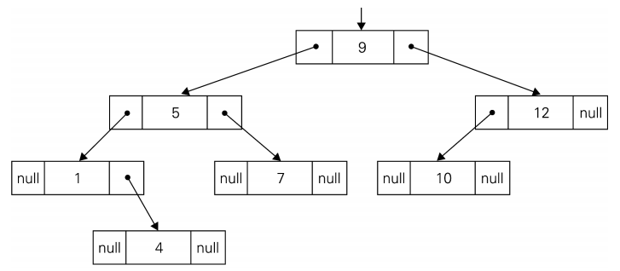
TREE EXAMPLE
Computer Science Department

Slide 17
AVL TREE
For each node in binary search tree, all keys on its left are ≤ to its key, and all keys on its right are ≥ to its key
In a balanced search tree, the height is Θ(log n), where n is the number of nodes
For each node in an AVL tree, the heights of the left and right subtree are equal or diﬀer by one.
The balance factor is the left height minus the right height.
Tree rotations are used to transform the tree into balance.
Computer Science Department

Slide 18
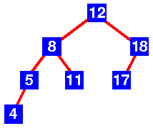
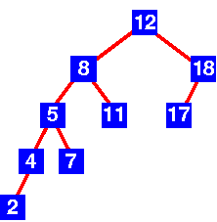
EXAMPLES
Computer Science Department
Notes:
Left – AVL
Right – not AVL
Discuss left heavy, right heavy, balanced
If an insertion destroys the balance, rotation is done to the tree

Slide 19
BINARY EXPONENTIATION
ALGORITHM LeftRightBinaryExponentiation(a, b(n))
//Computes an by the left-to-right binary exponentiation algorithm
//Input: A number a and a list b(n) of binary digits bI , ..., b0 in the binary expansion of a positive integer n
//Output: The value of a^{n}
product← a
for i ← I − 1 downto 0 do
product ← product ∗ product
if b_{i} = 1 product ← product ∗ a
return product
Computer Science Department

Slide 20
BINARY EXPONENTIATION
Compute a¹³ by the left-to-right binary exponentiation algorithm. Here, n = 13 = 1101₂.
binary digits of n product accumulator | 1 | 1 | 0 | 1
 | a | a² · a = a³ | (a³)² = a⁶ | (a⁶)² · a = a¹³
Computer Science Department

Slide 21
PROBLEM REDUCTION
This variation of transform-and-conquer solves a problem by a transforming it into different problem for which an algorithm is already available.
To be of practical value, the combined time of the transformation and solving the other problem should be smaller than solving the problem as given by another method.
Computer Science Department

Slide 22
EXAMPLES OF SOLVING PROBLEMS BY REDUCTION
computing lcm(m, n) via computing gcd(m, n)
lcm(m,n) = m*n / gcd(m,n)
  has improvement since Euclid’s algorithm is fast.
  counting number of paths of length n in a graph by raising the graph’s adjacency matrix to the n-th power
  transforming a maximization problem to a minimization problem and vice versa (also, min-heap construction)
Computer Science Department

Slide 23
PROBLEM REDUCTION
linear programming
reduction to graph problems
(e.g., solving puzzles via state-space graphs)
Computer Science Department

